Slide 1

Nutrient availability increases leaf nitrogen at the expense of whole plant growth in a closed canopy temperate forest
Evan A. Perkowski¹; David W. Frey²; Christine L. Goodale²; Nicholas G. Smith¹
¹Dept. of Biological Sciences, Texas Tech University
²Dept. of Ecology and Evolutionary Biology, Cornell University

Slide 2
Leaf nitrogen is a common surrogate for estimating leaf-level photosynthetic capacity
@EvanPerkowski
Evans (1989) Oecologia

Slide 3
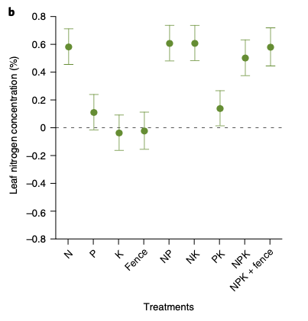
Soil nitrogen has been shown to positively influence leaf nitrogen
@EvanPerkowski
Firn et al. (2019) Nature

Slide 4
Soil nitrogen has been shown to positively influence leaf nitrogen
Plots that received nitrogen had higher leaf nitrogen content
@EvanPerkowski
Firn et al. (2019) Nature

Slide 5
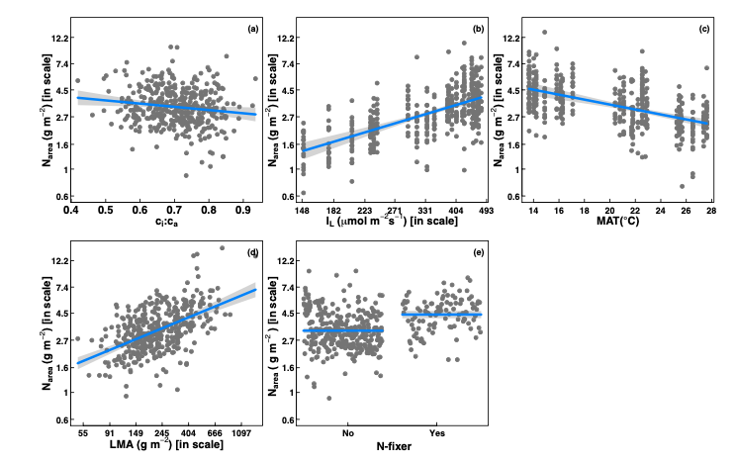
However, leaf nitrogen can also be predicted independent of soil nitrogen
@EvanPerkowski
Dong et al. (2017) Biogeosciences

Slide 6
Leaf nitrogen is likely a product of plant allocation responses to soil nitrogen and climate
@EvanPerkowski

Slide 7
Yet, we do not fully understand when and where soil nitrogen impacts nitrogen allocation to leaf tissue vs. other tissues
@EvanPerkowski
Notes:
We still don’t fully understand when and where plants allocate nitrogen to leaves, and this is mostly due to a lack of photosynthetic data in nitrogen manipulation experiments

Slide 8
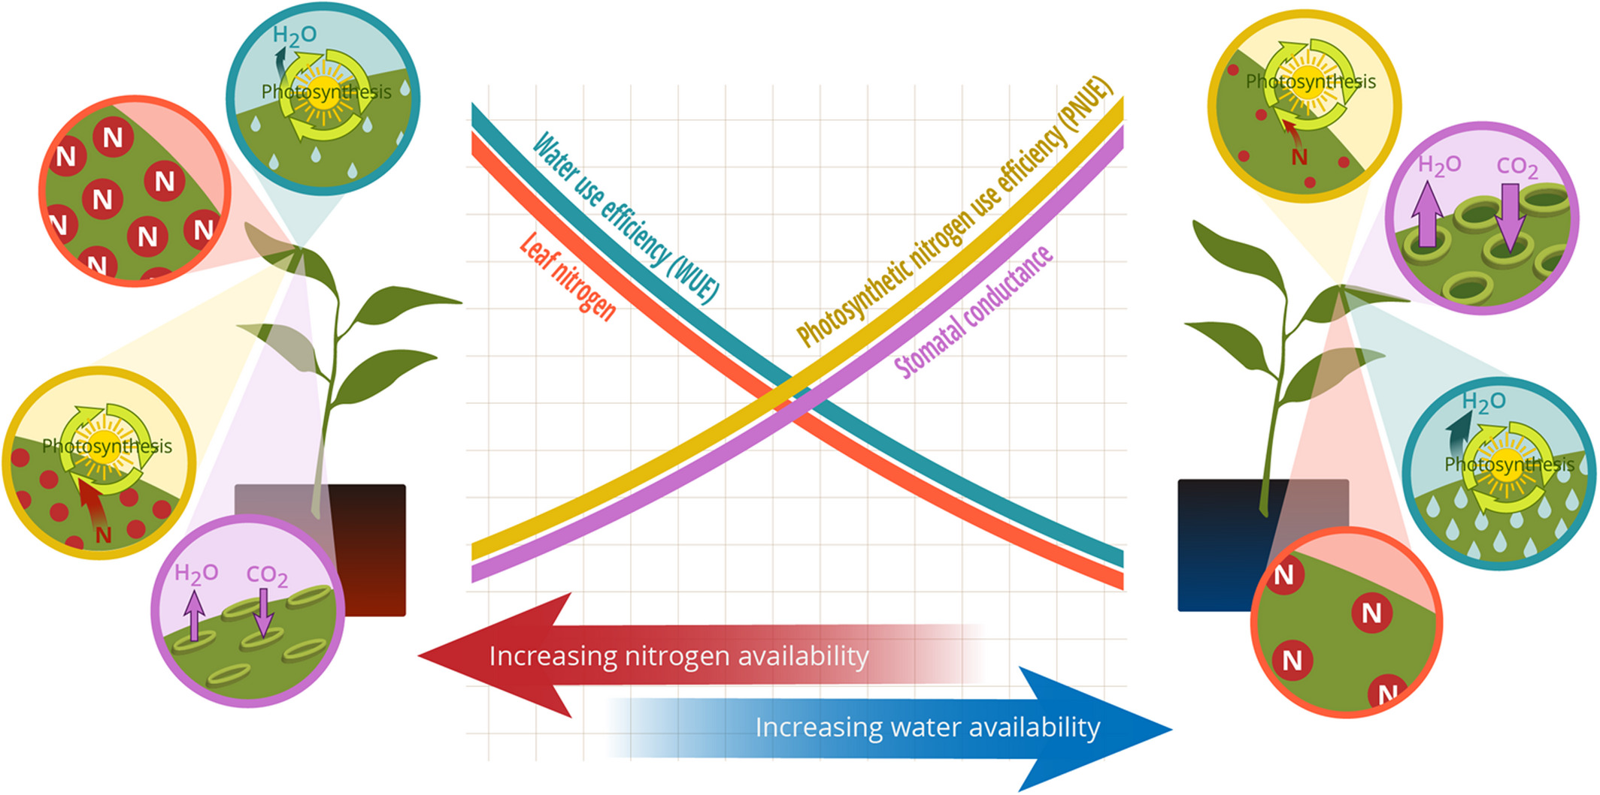
Option #1: Maintain photosynthesis with greater water-use efficiency at expense of photosynthetic nitrogen-use efficiency
@EvanPerkowski
Bialic-Murphy et al. (2021) Ecol. Letters
Notes:
At the leaf level, plants might allocate nitrogen to photosynthetic leaf tissue based on tradeoffs between nitrogen and water availability.
This option is predicated on recent optimality frameworks suggesting that plants can and should trade efficient use of an abundant resource for a more limited limiting resource.
For example, if nitrogen is relatively more available than water, then plants can maintain a similar photosynthetic output by increasing nitrogen allocation toward photosynthetic leaf tissue in order to increase water-use efficiency.
We might expect these patterns would be observed in arid systems where water is relatively less available than nitrogen

Slide 9
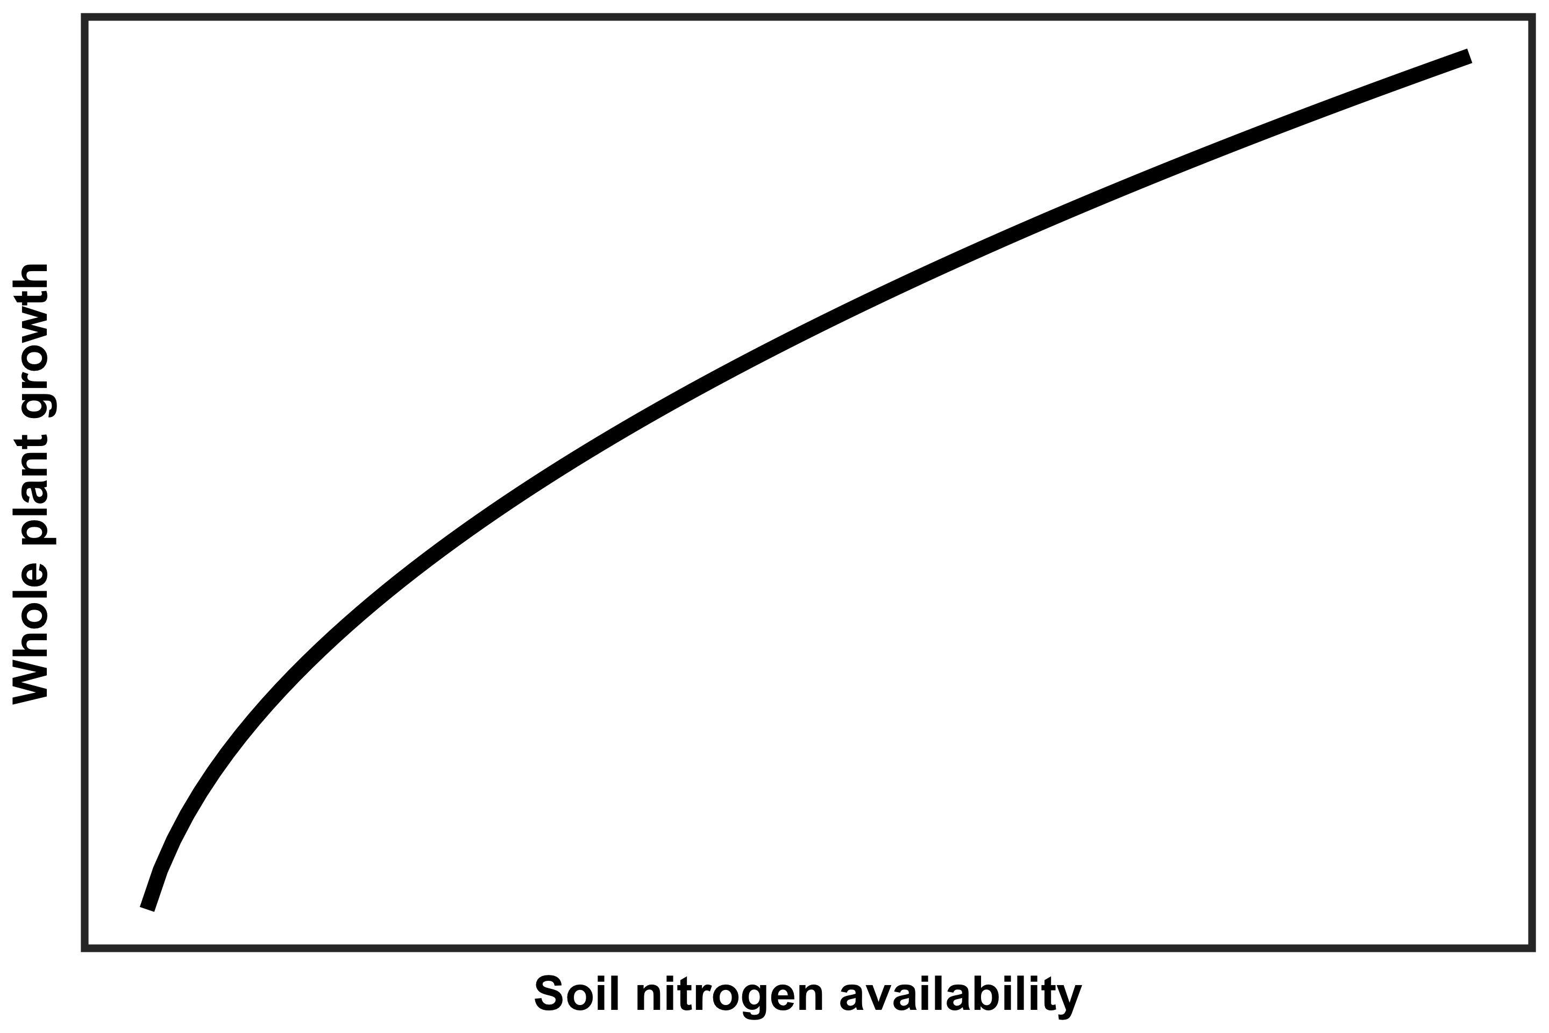
Option #2: Invest extra nitrogen toward whole plant growth at expense of leaf nitrogen
@EvanPerkowski
Notes:
Alternatively, plants may allocate nitrogen to photosynthetic leaf tissue based on tradeoffs between leaf-level nitrogen demand and whole plant nitrogen demand.
In other words, if plants invest extra nitrogen toward whole plant growth, then this should come at the expense of leaf nitrogen.
This could be indexed through nitrogen investment in leaf quantity over quality, or toward maintenance of structural tissue essential for the survival and reproduction of an individual
These allocation patterns may be a response of canopy light availability, where plants allocate extra nitrogen toward photosynthetic leaf tissue in open canopy systems and toward whole plant growth in closed canopy systems

Slide 10
Study Question
How do leaf and whole plant processes respond to soil nutrient availability in a closed canopy system?
@EvanPerkowski
Notes:
So, using the hypotheses explained in the two options before, we wanted to know how leaf and whole plant processes responded to a soil nutrient addition experiment.

Slide 11
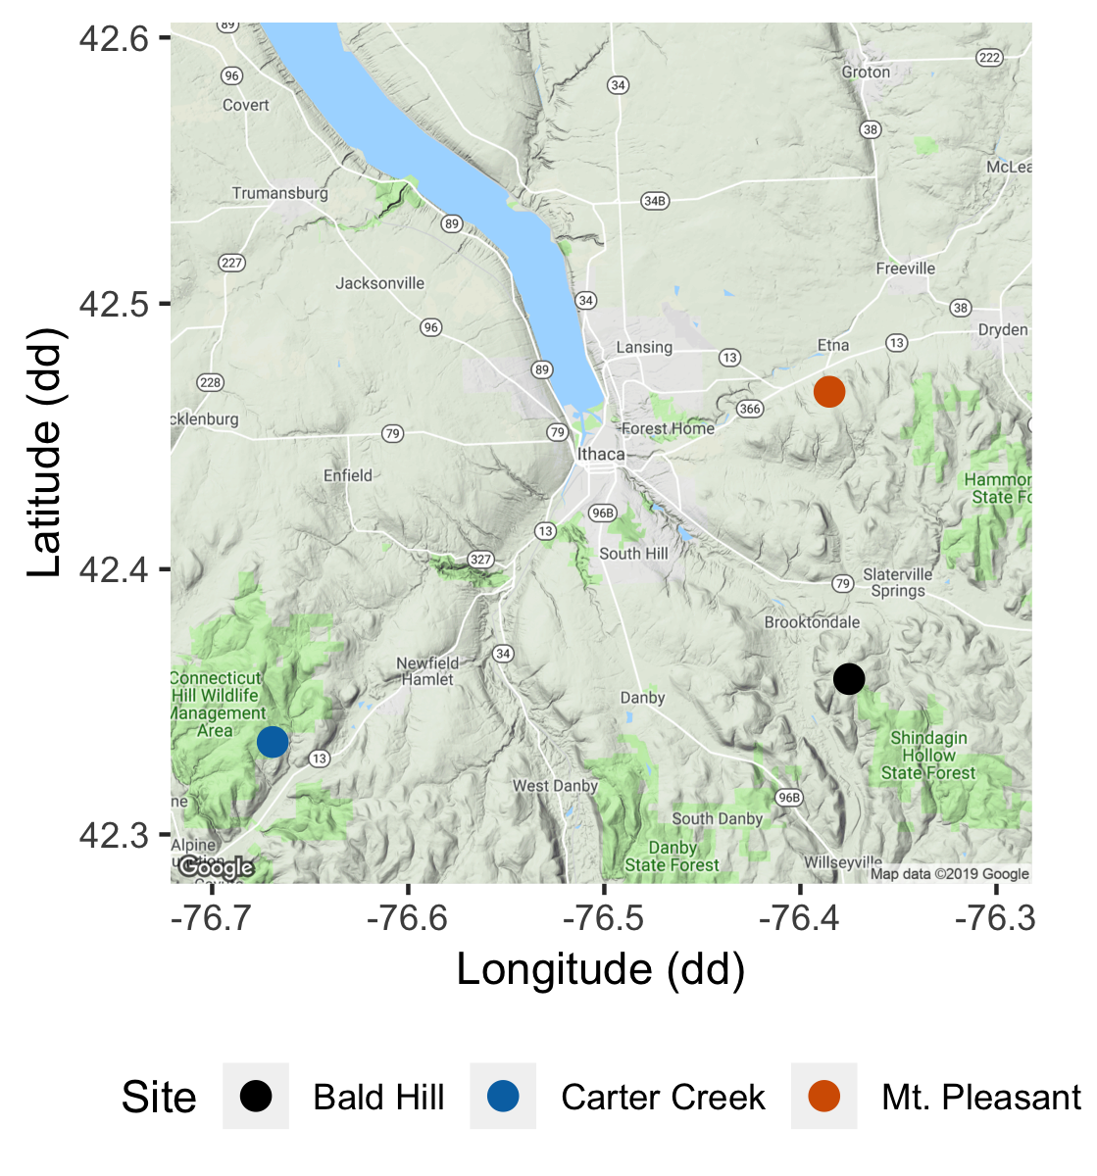
Study system
Soil fertilization treatments
Sites
0 kg ha⁻¹ yr⁻¹ N; 0 kg ha⁻¹ yr⁻¹ S
Bald Hill
0 kg ha⁻¹ yr⁻¹ N;
57 kg ha⁻¹ yr⁻¹ S
Mount Pleasant
50 kg ha⁻¹ yr⁻¹ N;
0 kg ha⁻¹ yr⁻¹ S
Carter Creek
50 kg ha⁻¹ yr⁻¹ N; 57 kg ha⁻¹ yr⁻¹ S
@EvanPerkowski
Notes:
We used the following field manipulation experiment to investigate whether changes in soil resource availability influenced leaf quantity/quality tradeoffs or water/nitrogen use tradeoffs.
Starting in 2010, our coauthor Christy Goodale set up a full-factorial nitrogen-by-sulfur field manipulation experiment at three sites in a contiguous closed canopy forest all within a 20-km radius of Ithaca, New York
This experiment was originally created to tease apart the impacts of soil pH change and soil nitrogen fertilization on forest systems;
however, because sulfur additions acidify the soil and promote nitrogen losses over time, this system provides a unique soil nitrogen availability gradient to test our hypotheses.

Slide 12
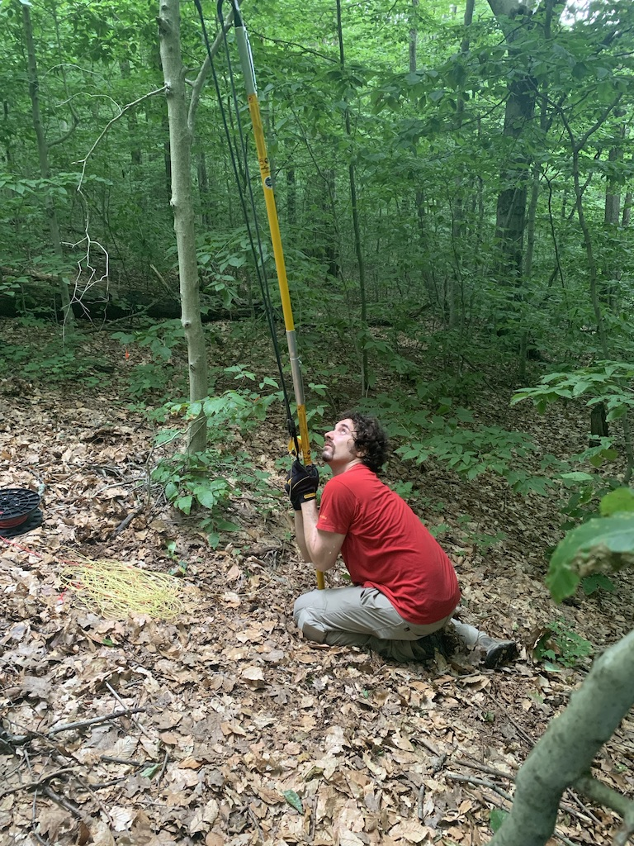
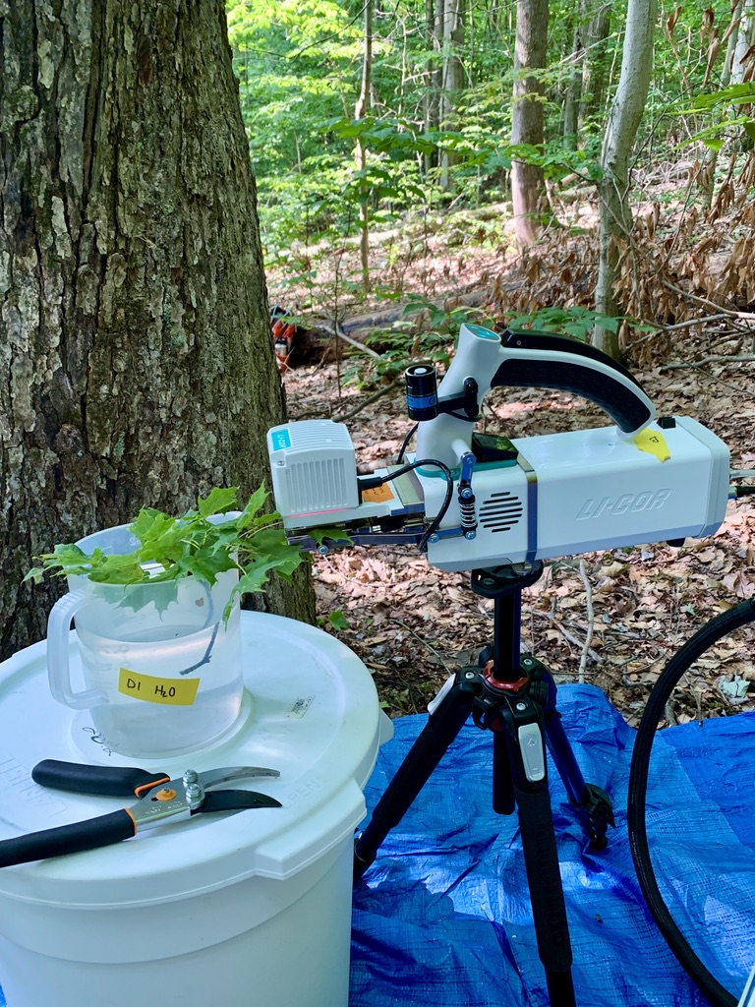
Leaf sampling
Fully sunlit canopy leaves brought down with arborist’s slingshot
Branches recut underwater
CO₂ response curve using LI-COR 6800
@EvanPerkowski
Notes:
We collected fully sunlight canopy leaves from each of the plots using an arborist’s slingshot and used a LI-COR 6800 to measure carbon dioxide response curves

Slide 13
Plant measurements
Leaf-level measurements
Whole plant measurements
Net photosynthesis and biochemical process rates
Leaf nitrogen per unit leaf area
PNUE
iWUE
Change in basal area between 2011 and 2019
Relative growth rate using allometrically-scaled whole tree biomass
@EvanPerkowski
Notes:
In addition to net photosynthesis and biochemical process rates, we also quantified leaf nitrogen per unit leaf area and foliar d13C.
We also quantified photosynthetic nitrogen-use and intrinsic water-use efficiency.
At the whole plant level, we calculated the change in basal area between 2011 and 2019 to get an estimate of woody tissue production and estimated relative growth rate between the same years using allometrically-scaled biomass data

Slide 14
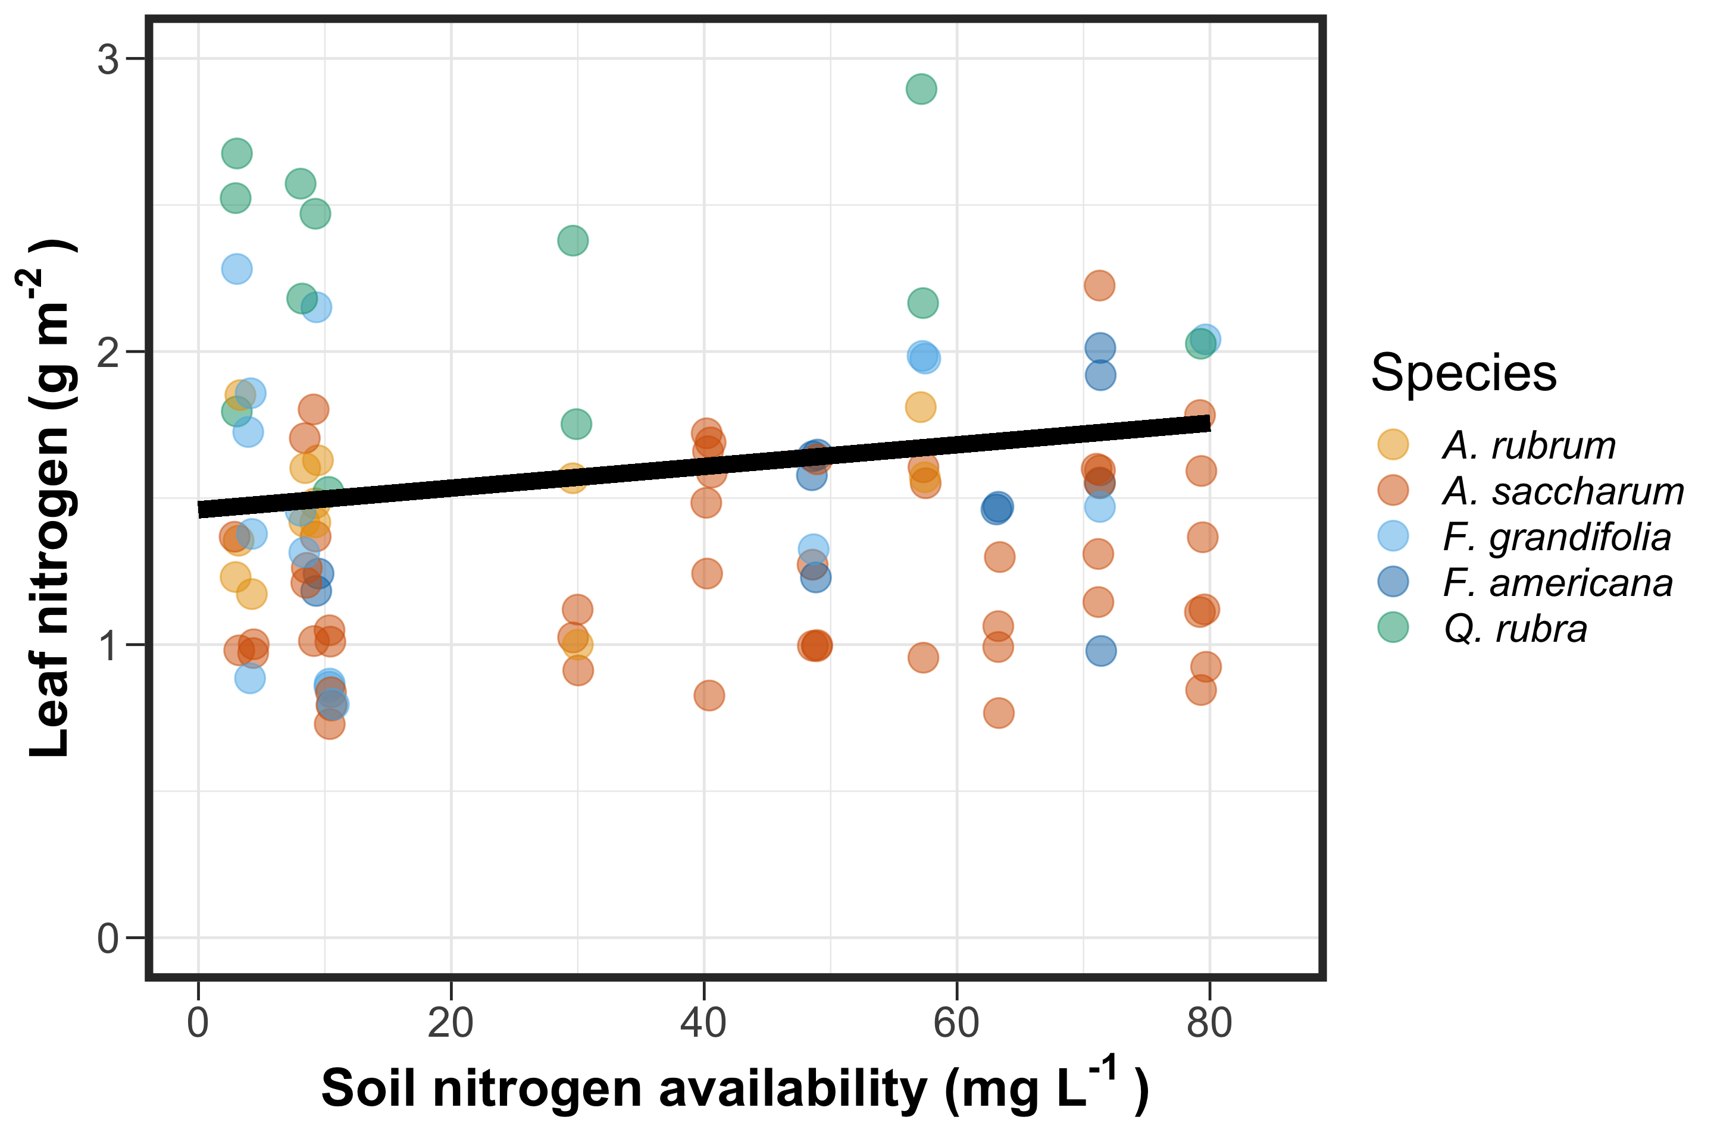
@EvanPerkowski
Notes:
Before I get into the results, I want to orient everyone on the structure of our figures
Soil nitrogen availability is represented on the x-axis. Importantly, we used resin bags to quantify soil nitrogen availability, so soil nitrogen availability is represented on a continuous basis
Our response variable is listed on the y-axis
Individual points represent individual measurements, and different colors represent species identity of that measurement
Finally, we include trendlines to determine whether soil nitrogen availability influenced a given response variable.
Importantly, this trendline represents patterns when averaged across species, so these patterns are more reflective of a community-level pattern than a population-level pattern

Slide 15
Soil nitrogen availability increases leaf nitrogen
20.27% increase
@EvanPerkowski

Slide 16
Soil nitrogen availability increases photosynthetic capacity
@EvanPerkowski
Notes:
Soil nitrogen availability also influenced photosynthetic capacity. In this case, we refer to photosynthetic capacity as the light saturated photosynthetic rate measured at 400 ppm CO2

Slide 17
Soil nitrogen availability increases photosynthetic capacity
20.32% increase
@EvanPerkowski
Notes:
We find that soil nitrogen availability increased photosynthetic capacity when averaged across species
These findings could suggest that increased leaf nitrogen contributed to increased photosynthetic capacity

Slide 18
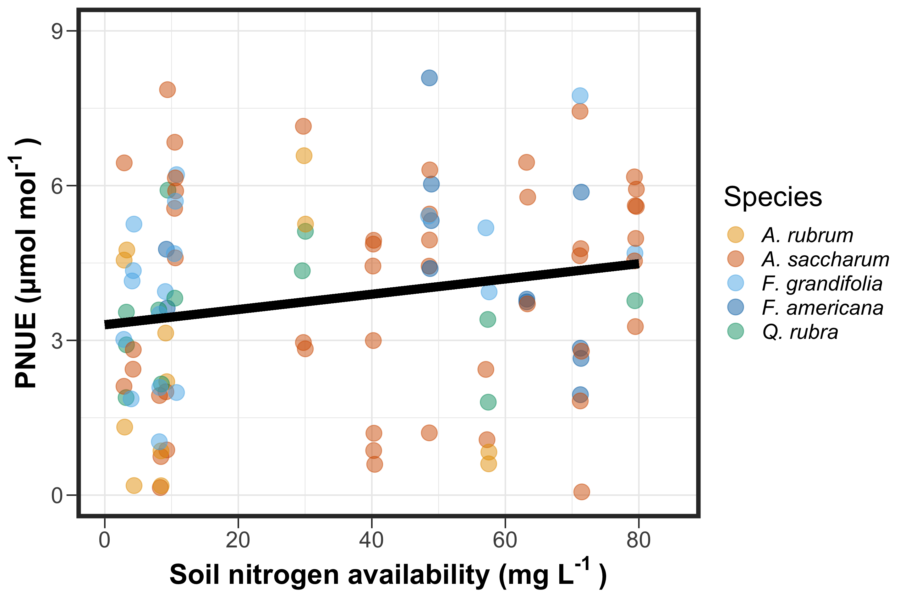
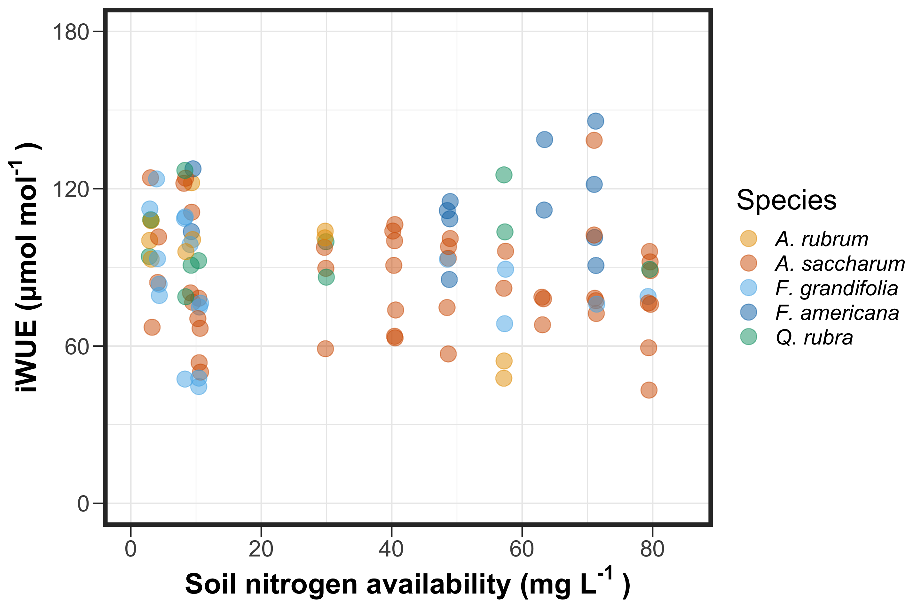
@EvanPerkowski
Notes:
Given what we know about tradeoffs between nitrogen and water use, plants maximize resource use by trading inefficient use of a relatively more abundant resource for efficient use of a relatively less abundant resource
Increased soil nitrogen availability should therefore cause soil nitrogen to become increasingly more abundant than water, which might cause plants to trade more inefficient use of nitrogen for efficient use of water.
This would cause plants to decrease nitrogen-use efficiency and increase water-use efficiency
We might expect that increased soil nitrogen availability would decrease the relative cost of acquiring and using nitrogen relative to the relative cost of acquiring and using water.

Slide 19
Soil nitrogen availability increases photosynthetic nitrogen-use efficiency…
35.85% increase
@EvanPerkowski
Notes:
Interestingly, we observed the opposite pattern for photosynthetic nitrogen-use efficiency, where soil nitrogen availability increased photosynthetic nitrogen use efficiency.
This was likely driven by an increase in leaf nitrogen that corresponded with an increase in photosynthetic capacity

Slide 20
… but not water-use efficiency
35.85% increase
@EvanPerkowski
Notes:
However, the observed increase in photosynthetic nitrogen-use efficiency did not correspond with any shift in water-use efficiency.
This was observed both for intrinsic water-use efficiency (pictured in the right panel) and with foliar delta carbon 13 data, which is a more integrated measure of water-use efficiency across a leaf’s lifespan
Together, these findings suggest that trees in these plots are not differentially allocating nitrogen to maximize resource use, which makes sense because this is a nitrogen addition experiment in a temperate region that receives just over 900 mm of precipitation per year.
Therefore, it makes sense that we wouldn’t see a strong nitrogen/water use tradeoff, as both resources are not necessarily limited or limiting in this system

Slide 21
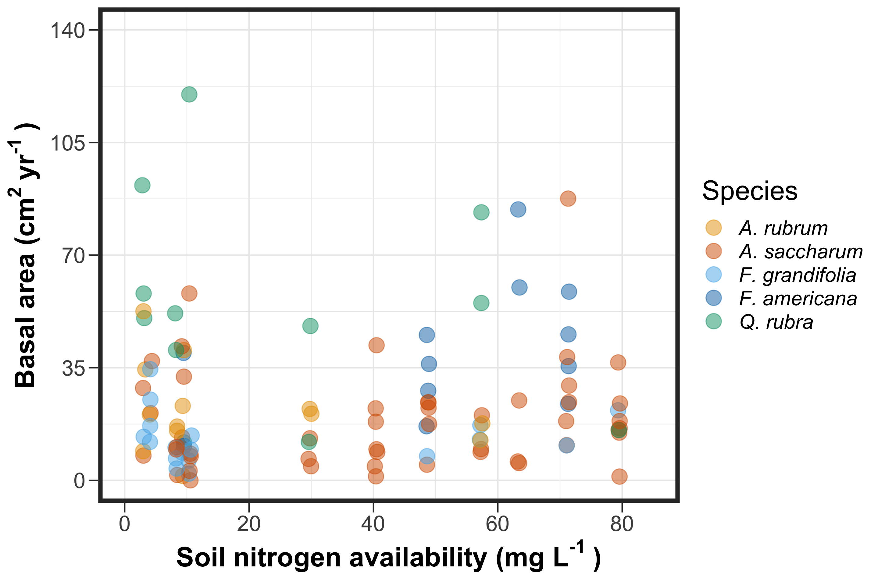
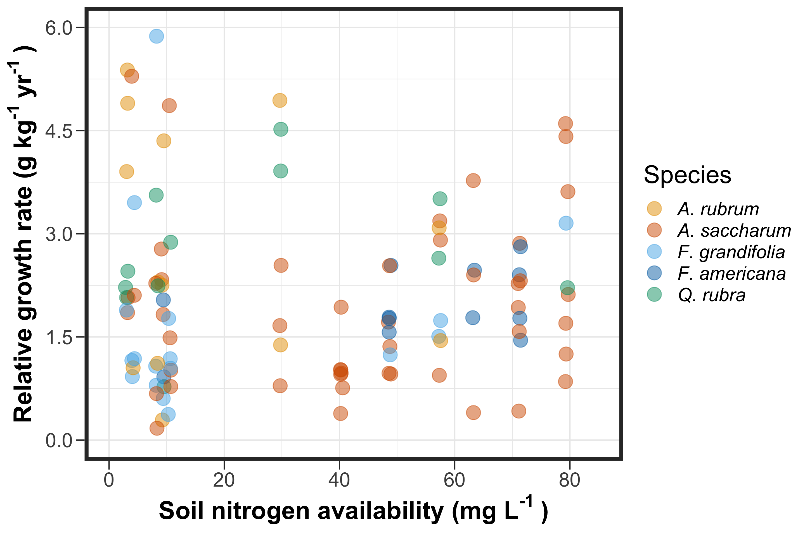
If leaf nitrogen increases with increasing soil nitrogen availability, then:
No change
No change
@EvanPerkowski
Notes:
However, we might expect a stronger signature when we look at tradeoffs between leaf and whole plant nitrogen allocation
Given what we know from tradeoffs between leaf and whole plant nitrogen allocation, we would expect that:
If soil nitrogen availability increases leaf nitrogen, that there would be a smaller simulation of whole plant biomass production and growth

Slide 22
Soil nitrogen availability does not influence woody tissue production…
@EvanPerkowski

Slide 23
… or relative growth rate
@EvanPerkowski

Slide 24
Revisiting Option 1
Did soil N allow photosynthesis rates to be achieved with higher water use efficiency at the expense of nitrogen-use efficiency?
@EvanPerkowski
Bialic-Murphy et al. (2021) Ecol. Letters

Slide 25
Revisiting Option 1
Did soil N allow photosynthesis rates to be achieved with higher water use efficiency at the expense of nitrogen-use efficiency?
No, increased soil N increased nitrogen-use efficiency and did not influence water-use efficiency
@EvanPerkowski
Bialic-Murphy et al. (2021) Ecol. Letters

Slide 26
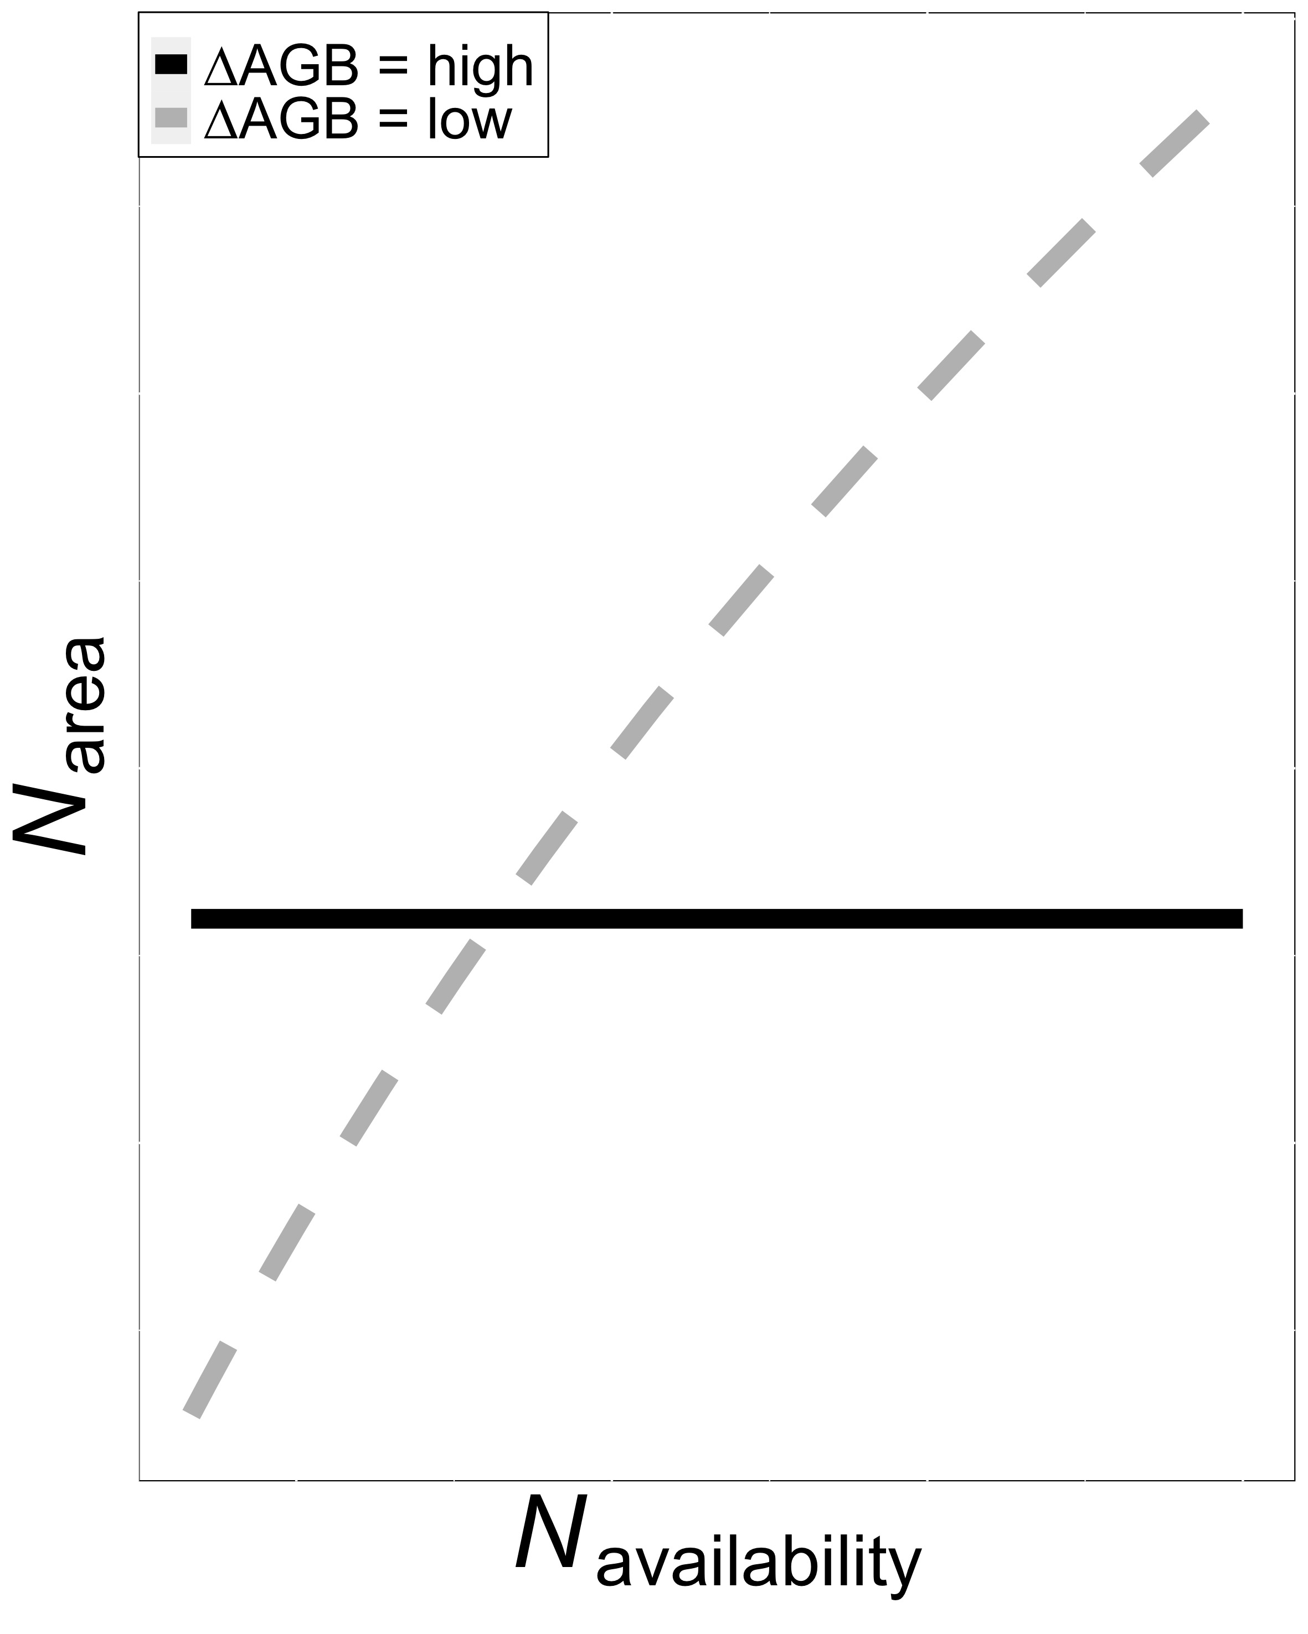
Revisiting Option 2
Did soil N invoke tradeoffs between biomass production and N_{area}?
@EvanPerkowski
Smith et al. (in prep)

Slide 27
Revisiting Option 2
Did soil N invoke tradeoffs between biomass production and N_{area}?
Yes! Soil N did not influence whole plant growth, but increased N_{area}.
@EvanPerkowski
Smith et al. (in prep)

Slide 28
Final thoughts
Trees invested more nitrogen toward leaf tissue at expense of whole plant growth
Overinvest in leaf nitrogen to be more productive during high sunlight hours
System is experiencing high rates of tree mortality – freeing of canopy space?
@EvanPerkowski

Slide 29
Future and Ongoing Work
What is the role of light availability in driving demand to allocate nitrogen toward photosynthetic leaf tissue vs. whole plant growth?
Are these patterns observed in other ecosystem and/or different canopy architecture types?
How do these results compare to those simulated by Earth system models?
@EvanPerkowski

Slide 30
Acknowledgements
USDA NIFA Award 2015-67003-23485
Texas Tech University
Risa McNellis (TTU)
Omair Irfan (Cornell)
Romin Abdolahzadi (Cornell)
Members of Schwilk & van Gestel labs (TTU)
Dr. Lizz Waring (TTU)
@EvanPerkowski
Notes:
Abdola-zadi

Slide 31

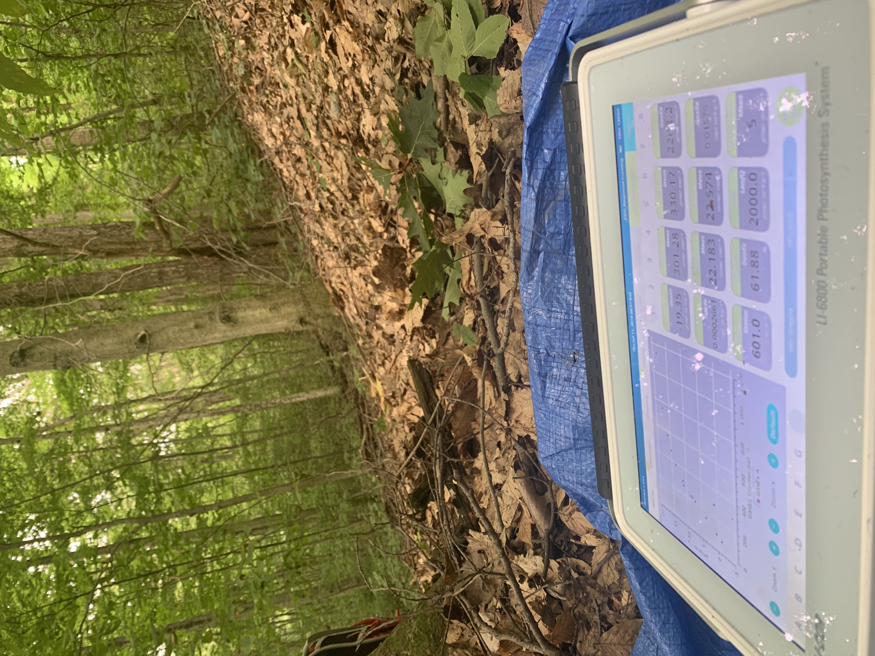
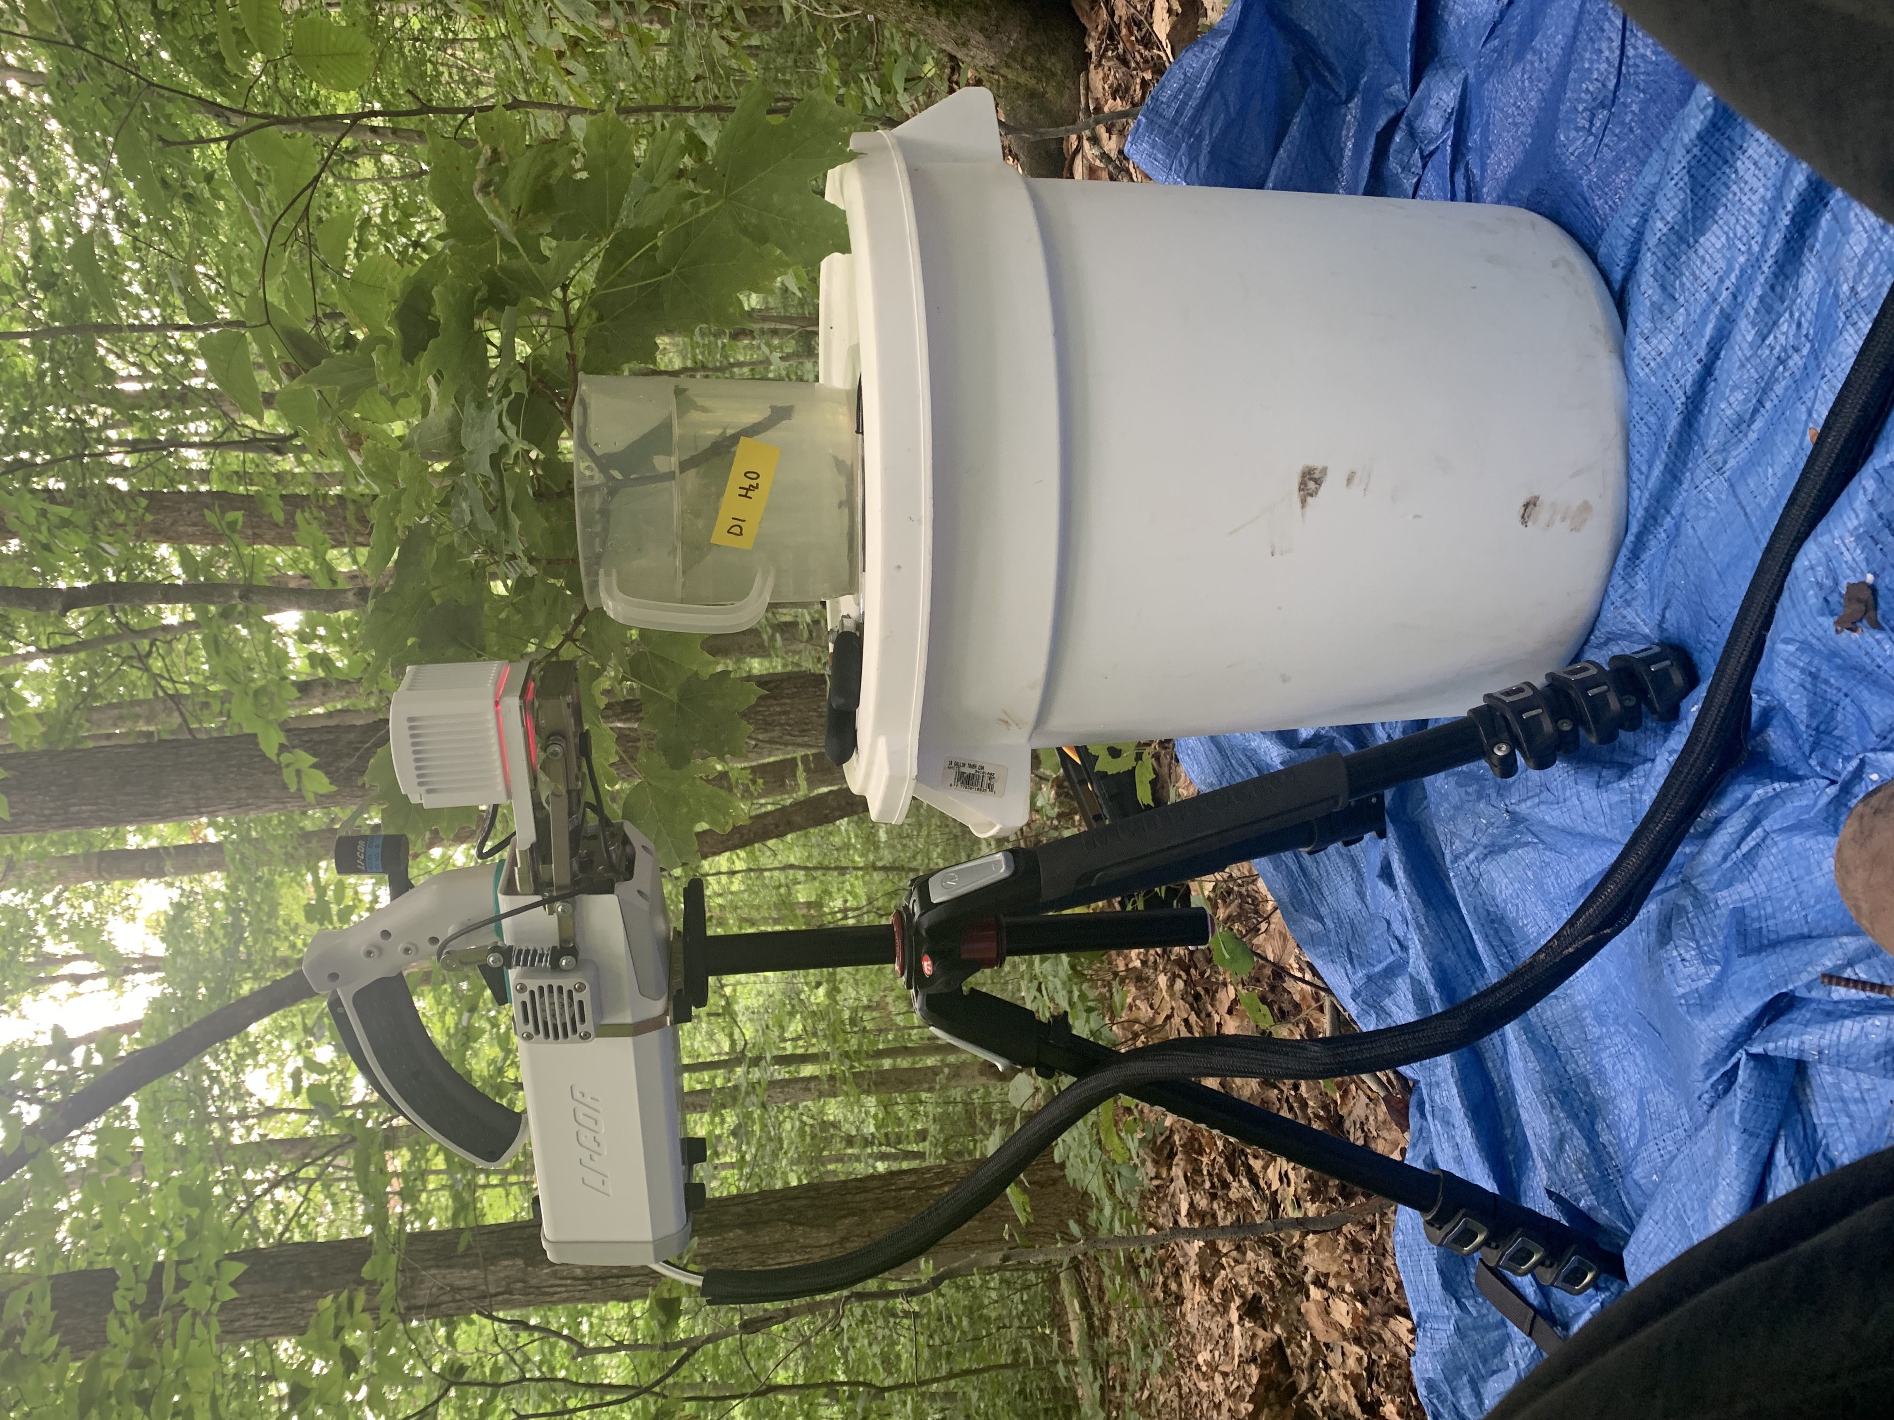
Thank you!
@EvanPerkowski

